Slide 1


ARTIFICIAL
INTELLIGENCE
Applications and its Theories
A.I.
Big Data
Images
Videos
IoT
Audios
Texts
Dr. Jia-Wei Chang
jwchang@nutc.edu.tw
jiaweichang@mail.ncku.edu.tw

Slide 2
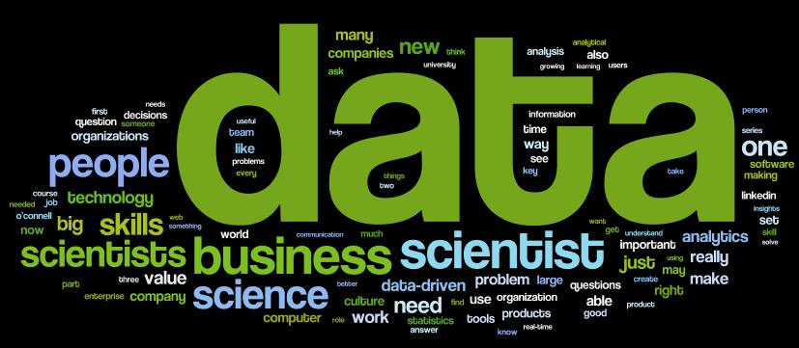

About Me
[Since Jan. 2019] Young Professionals Chair, IET Taipei Local Network.
[Since Dec. 2017] Consultant, NEXCOM Industry 4.0 Center.
[Jan. 2017] Ph.D. degree, National Cheng Kung University.
Work Experience
2018/8 ~ Now
Assistant Professor
National Taichung University of
Science and Technology
2018/2 ~ Now
Adjunct Assistant Professor
National Cheng Kung University
2015/8 ~ 2017/11
Project Manager & Data Scientist
NEXCOM International Co., Ltd.
Research Topics
Natural Language Processing
Natural Language Understanding
Chatbot
Text Summarization / Classification
Deep Learning
Data Mining
Internet of Things
Smart Speaker

Slide 3
Keywords
Data to Intelligence
Natural Language Processing Lab, National Taichung University of Science and Technology

Slide 4
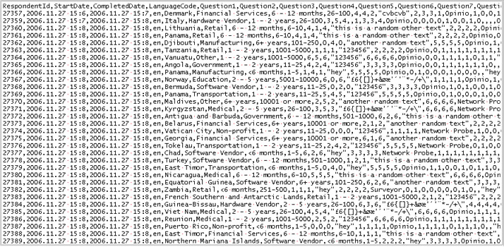
Data?
Natural Language Processing Lab, National Taichung University of Science and Technology

Slide 5
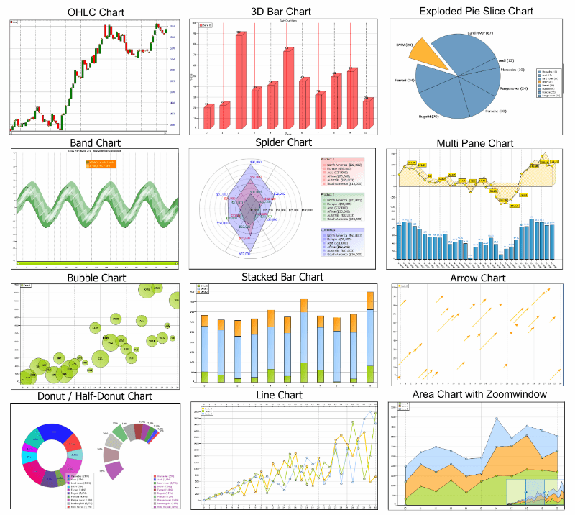
Information?
Natural Language Processing Lab, National Taichung University of Science and Technology

Slide 6




Keywords
Intelligence
Decision Making, Reasoning
Analysis, Judgement
Creativity, Thinking
Data
Information
Knowledge
Intelligence
Knowledge
Integration of Information, Experience, and Cultures
Specific Domain
High Expertise
Information
Data with preprocessing
Meaningful / Useful Clues
Data
Raw Records
Meaningless
Lack of organization or classification
Natural Language Processing Lab, National Taichung University of Science and Technology

Slide 7
Types
Natural Language Processing Lab, National Taichung University of Science and Technology

Slide 8
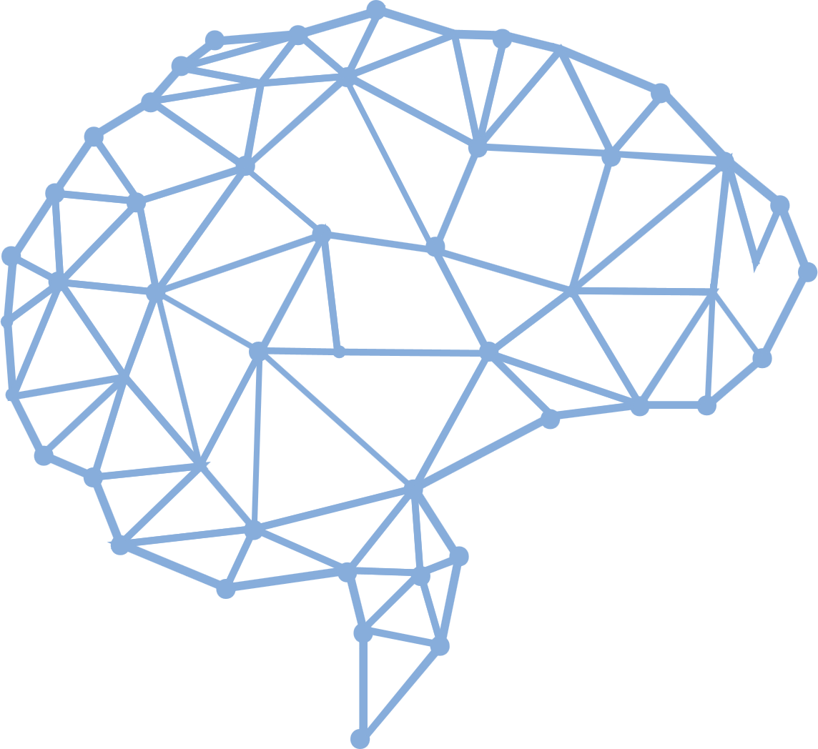
Types of A.I.
Strong A.I.
Make it smart likes a human beings.
Strong A.I. is expected to do anything that human can do. It is an AI-complete or AI-hard problem.
Weak A.I.
Make it to solve a specific problem.
For example, Chatbot or Object Detection.
Natural Language Processing Lab, National Taichung University of Science and Technology

Slide 9
Applications
A.I. Everywhere
Natural Language Processing Lab, National Taichung University of Science and Technology

Slide 10
A.I. Can Appear Everywhere
Social network applications
Marketing applications
Robots
Factories
Financial industry
Medicals
Chatbot
Car driving
Search engines
Natural Language Processing Lab, National Taichung University of Science and Technology

Slide 11


MARKETING APPLICATIONS
Natural Language Processing Lab, National Taichung University of Science and Technology

Slide 12



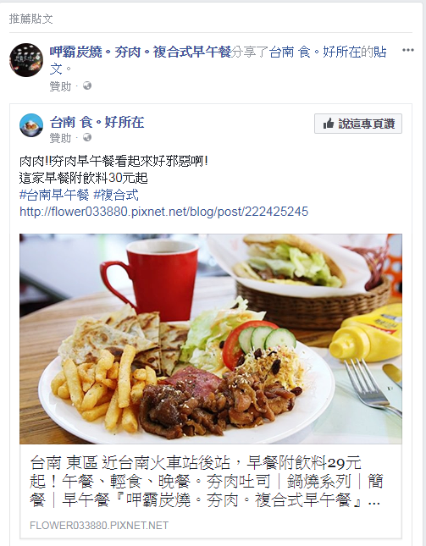




SOCIAL NETWORK APPLICATIONS
Natural Language Processing Lab, National Taichung University of Science and Technology

Slide 13

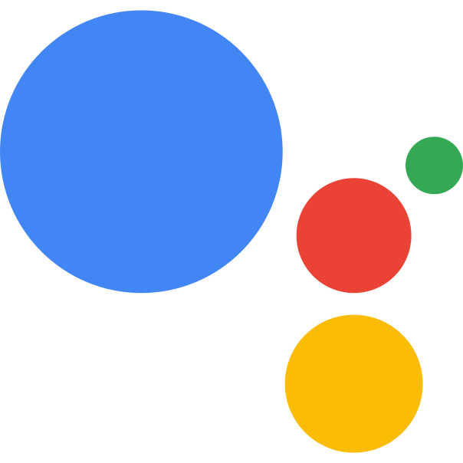

CHATBOT
Siri
Google Assistant
Natural Language Processing Lab, National Taichung University of Science and Technology

Slide 14

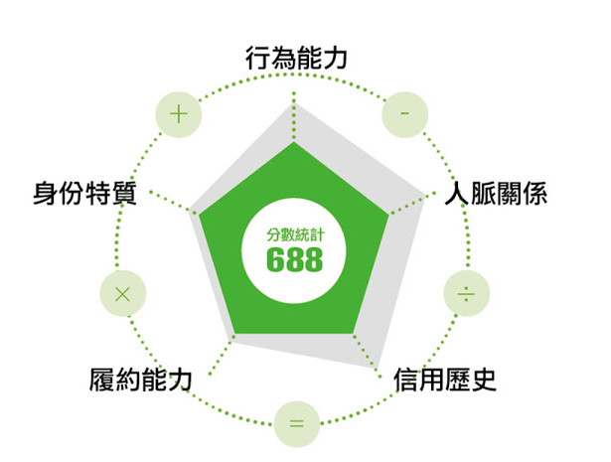
FINANCIAL INDUSTRY
Natural Language Processing Lab, National Taichung University of Science and Technology

Slide 15
AI FOR MEDICAL
醫療影像
Google、IBM、
騰訊、阿里、Intel
醫院管理
Qventus、CloudMedx
醫學研究
IBM、Microsoft、Hanover
輔助診療
IBM、百度
AI
醫療
健康管理
碳雲智能、 Validic、Evolent Health
藥物開發
IBM、BenevolentAI、Insilico Medicine
精準醫療
華大基因、Flatiron、Deep Genomics
虛擬助理
Microsoft、科大訊飛、Sense.ly
Natural Language Processing Lab, National Taichung University of Science and Technology

Slide 16

ROBOTS
Natural Language Processing Lab, National Taichung University of Science and Technology

Slide 17
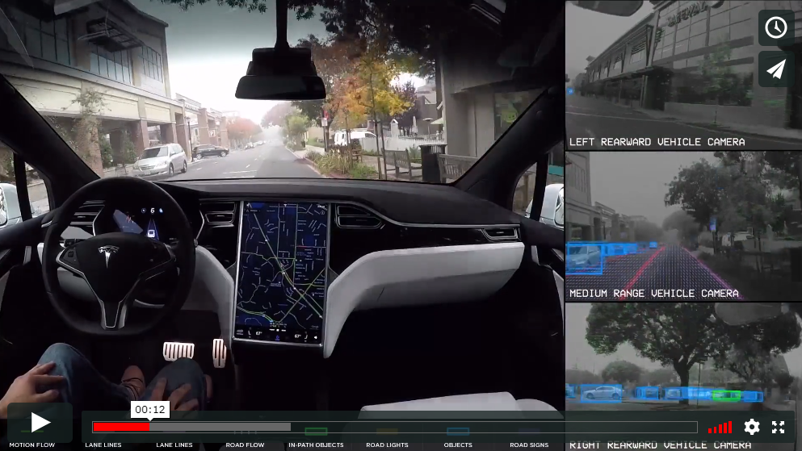
CAR DRIVINGS - Autopilot
Natural Language Processing Lab, National Taichung University of Science and Technology

Slide 18
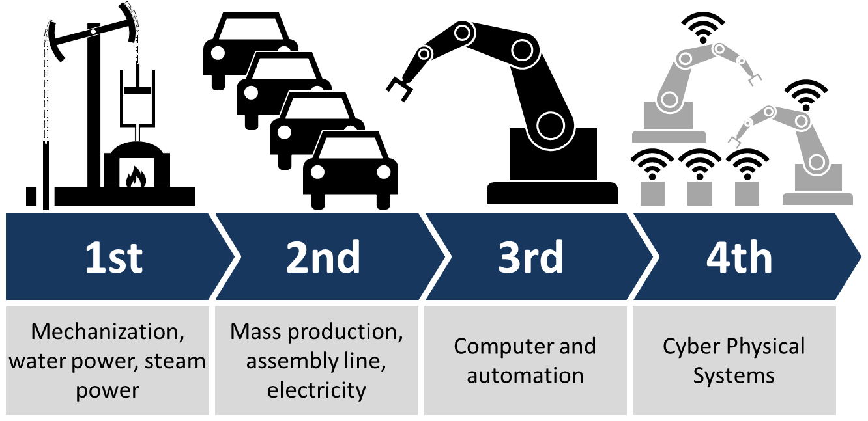
Industry 4.0
Natural Language Processing Lab, National Taichung University of Science and Technology

Slide 19






Data Driven Applications
Texts
Natural Language Processing
Categories
Audios
Signal Processing
Values
Data
Types
Images, Videos
Computer Vision
Networks
Internet of Things
Time Series

Slide 20
Methodology
Natural Language Processing Lab, National Taichung University of Science and Technology

Slide 21
A.I. History
1950-1960
1990-Now
2020-Future
Symbolicism
Machine Learning
What’s Next?
Where is Intelligence?
Thinking & Logic
Data
Perceptron,
1957-1962
SVM,
1995
Backpropagation & Convolution,
1980s
1980-1990
2006-Now
Expert Systems
AlphaGo, 2016
Deep Learning
Domain Knowledge
Data & Features
Natural Language Processing Lab, National Taichung University of Science and Technology

Slide 22
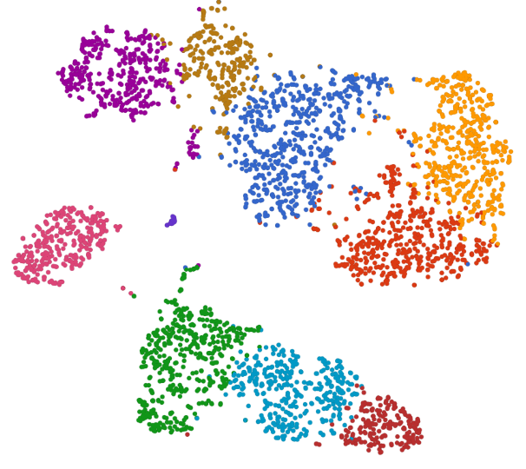


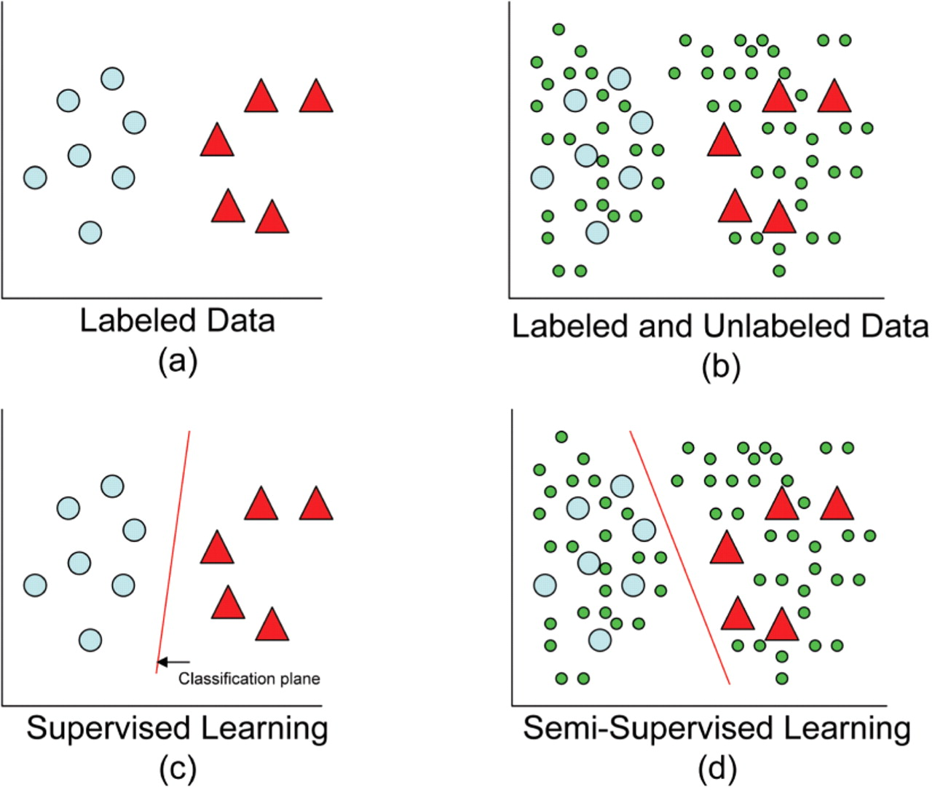


A.I. Methodology
Unsupervised Learning
Semi-supervised Learning
Discover the similarities between data.
Make the similar ones to be a group. Separate unsimilar groups as possible.
First train a supervised learning model, and then retrain the model to improve its robustness by unlabeled data.
Supervised Learning
Reinforcement Learning
Classify data into multiple categories.
Learn the identification rules from data and its labels.
First set reasonable rewards of game rules to the RL model, and then train the model via trial and error.
Reference:
https://academic.oup.com/bioinformatics/article/24/6/783/193709
https://documentation.partek.com/display/FLOWDOC/Graph-based+clustering
Natural Language Processing Lab, National Taichung University of Science and Technology

Slide 23
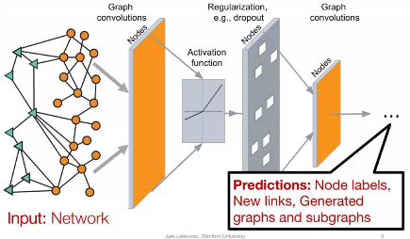
Evolution
Graph Neural Networks !?
Given input data in the form of Network.
Predict the node labels, new links and so on.
Reinforcement Learning
Q-learning
Deep Q Networks
RL in Deep Learning
Deep Learning
Generative Adversarial Network
Convolutional Neural Network
Long Short-Term Memory
Artificial Neural Network
Machine Learning
Support Vector Machine (Class)
Decision Tree (Class)
Support Vector Regression (Value)
Linear Regression (Value)
Data Mining
Clustering
Classification
Association Learning
Reference:
https://static.aminer.cn/misc/pdf/graphsage2-mit-nov19.pdf

Slide 24

My Works with A. I.
from Past until Now
A.I. Projects
Just for fun – NBA Projects
Semantic Analysis
Chinese Menu Recognition
Extubation Prediction: Cases in ICU
Smart Speaker / Chatbot
A.I. Musician
A.I. Lawyer

Slide 25
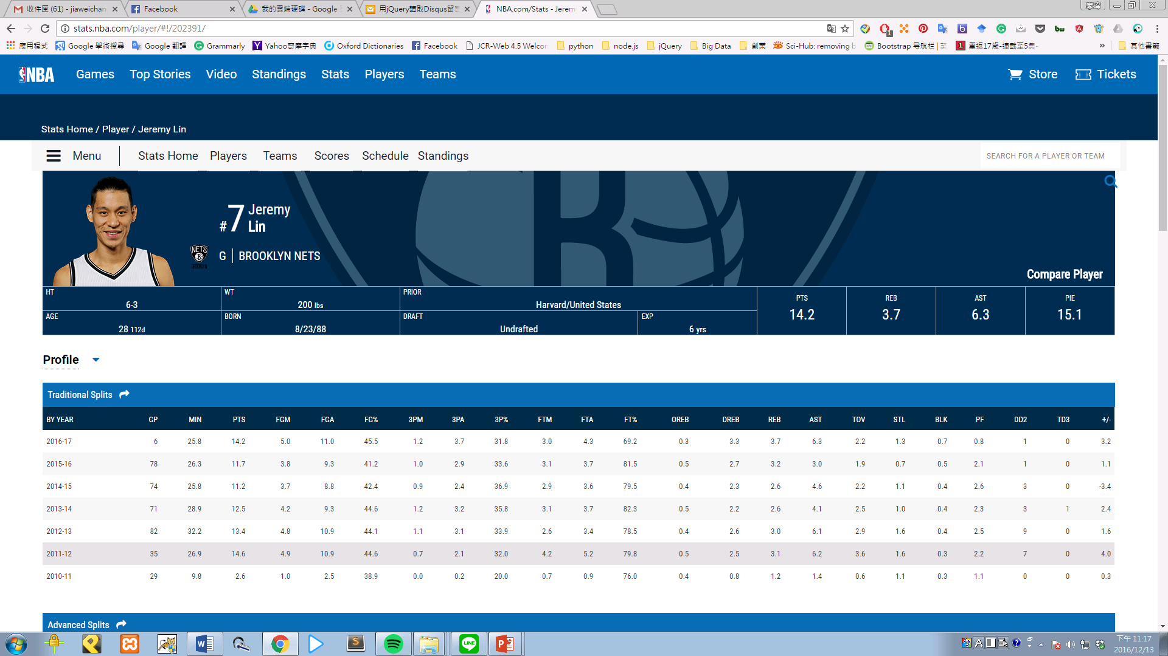
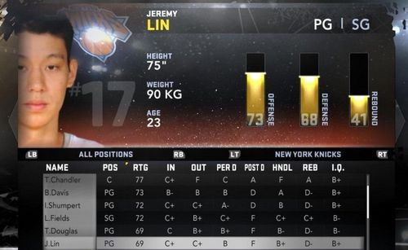
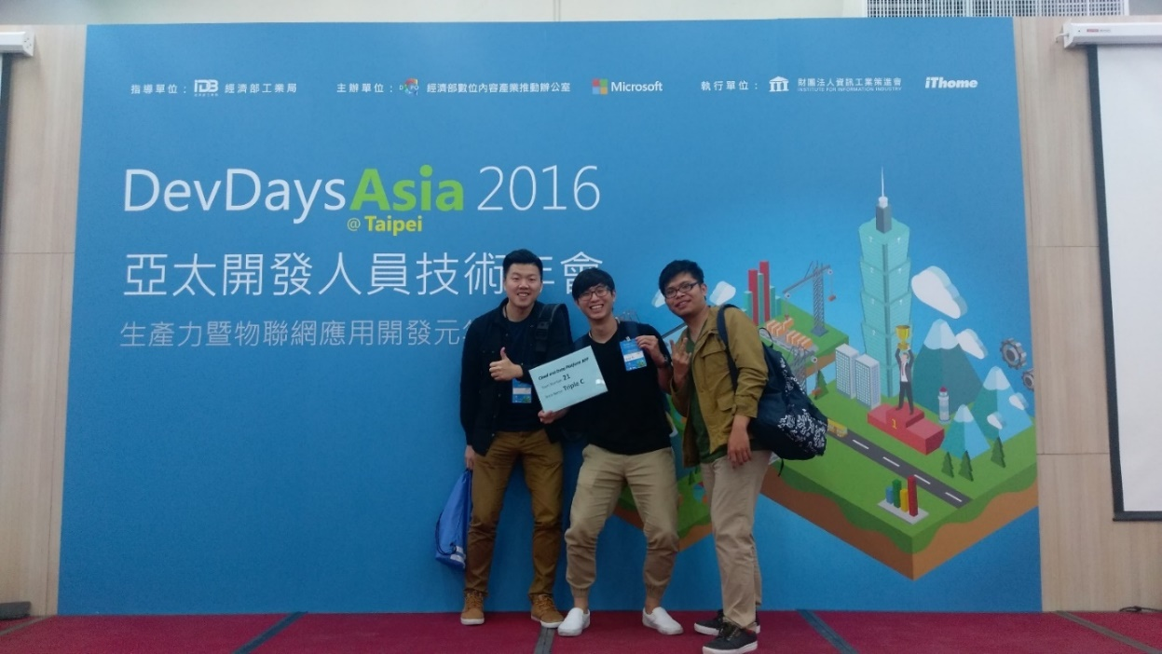
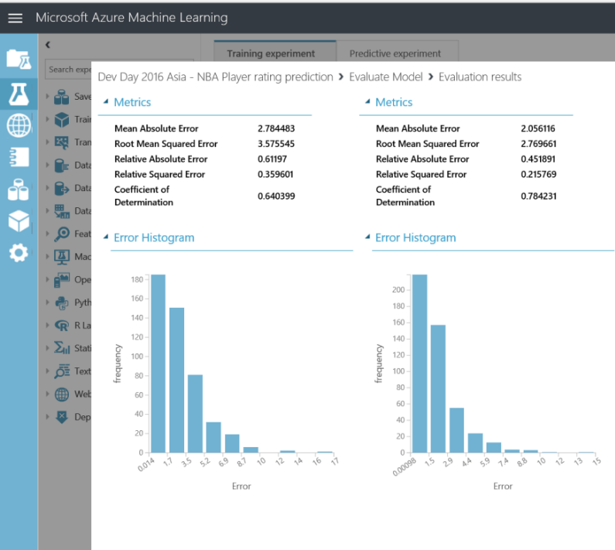
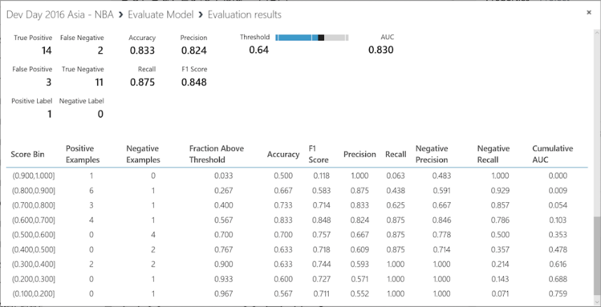
NBA Projects

Slide 26
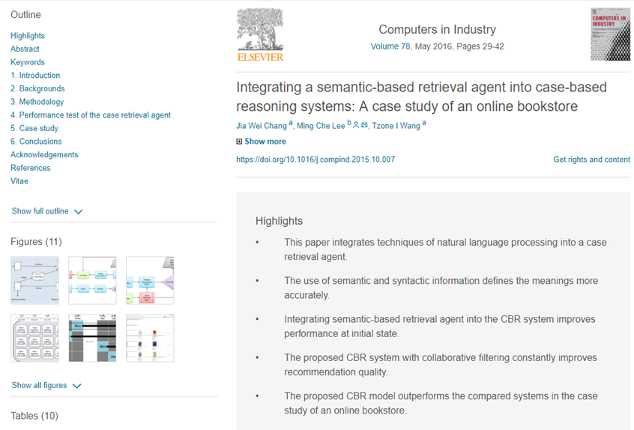
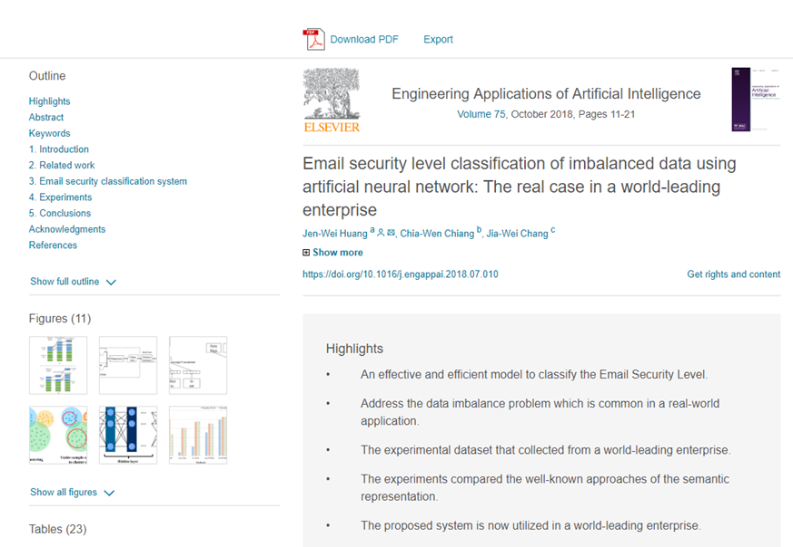
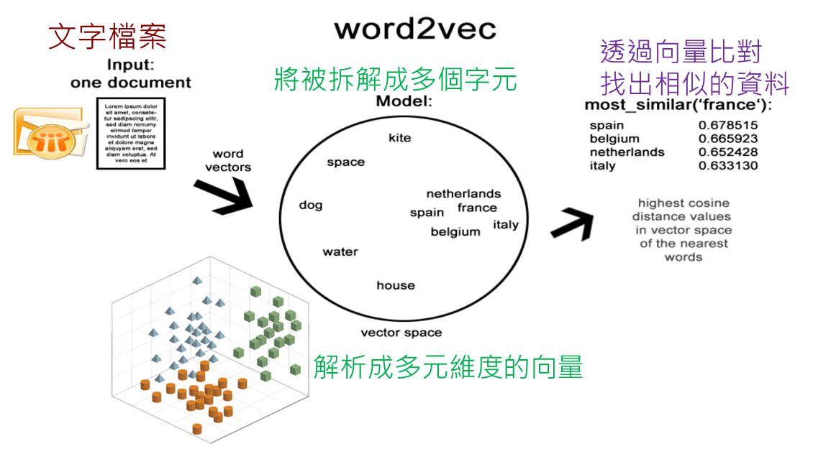
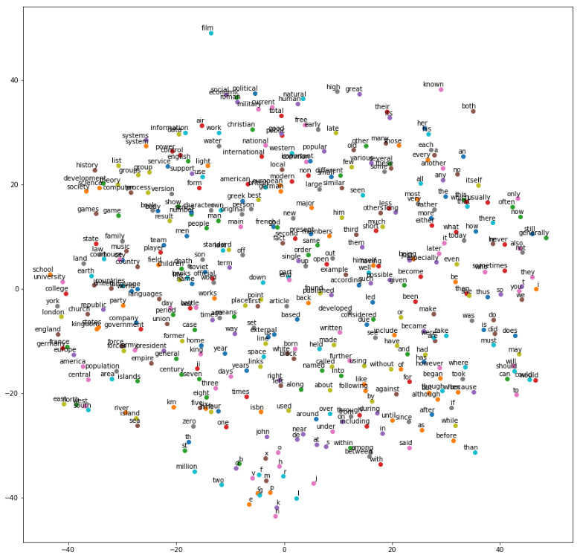
Semantic Analysis
Email Security Classification
Book Recommendation

Slide 27

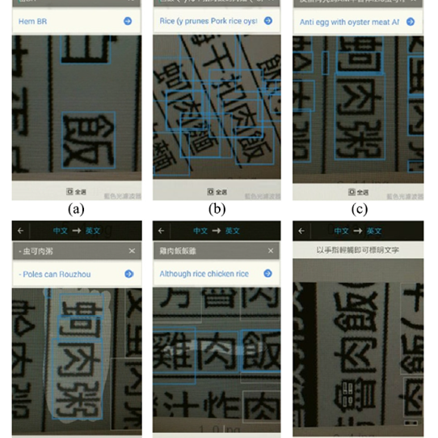
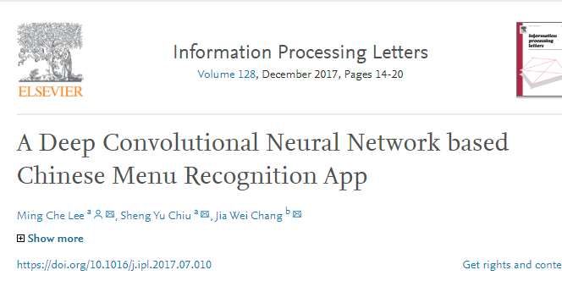
Chinese Menu Recognition
Lee, M. C., Chiu S. Y., & Chang, J. W. (2017) A Deep Convolutional Neural Network based Chinese Menu Recognition App. Information Processing Letters, 128, 14-20. https://doi.org/10.1016/j.ipl.2017.07.010
(SCI, COMPUTER SCIENCE, INFORMATION SYSTEMS)

Slide 28
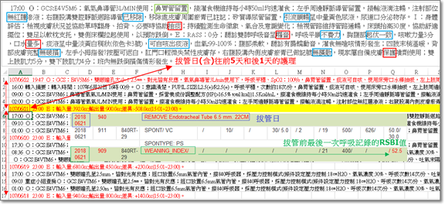
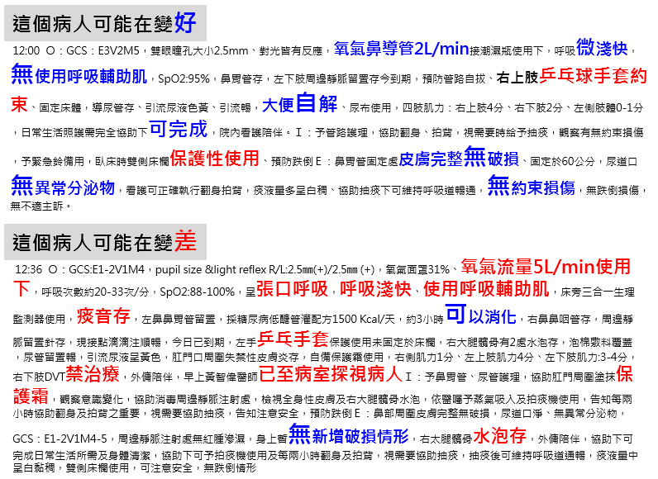
Extubation Prediction: Cases in ICU

Slide 29
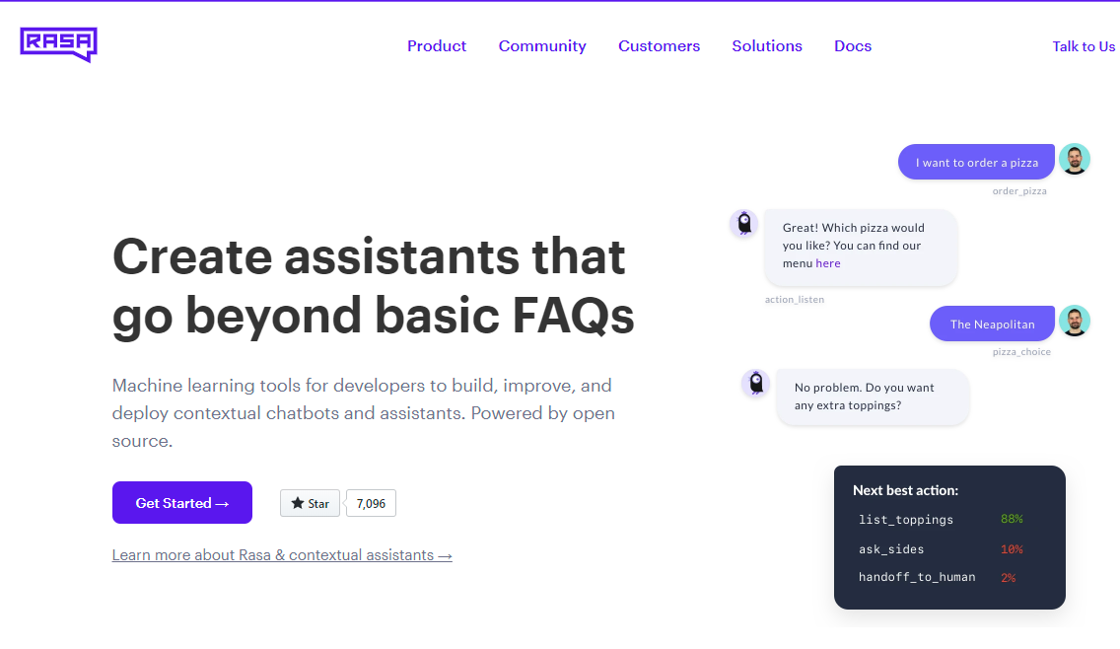
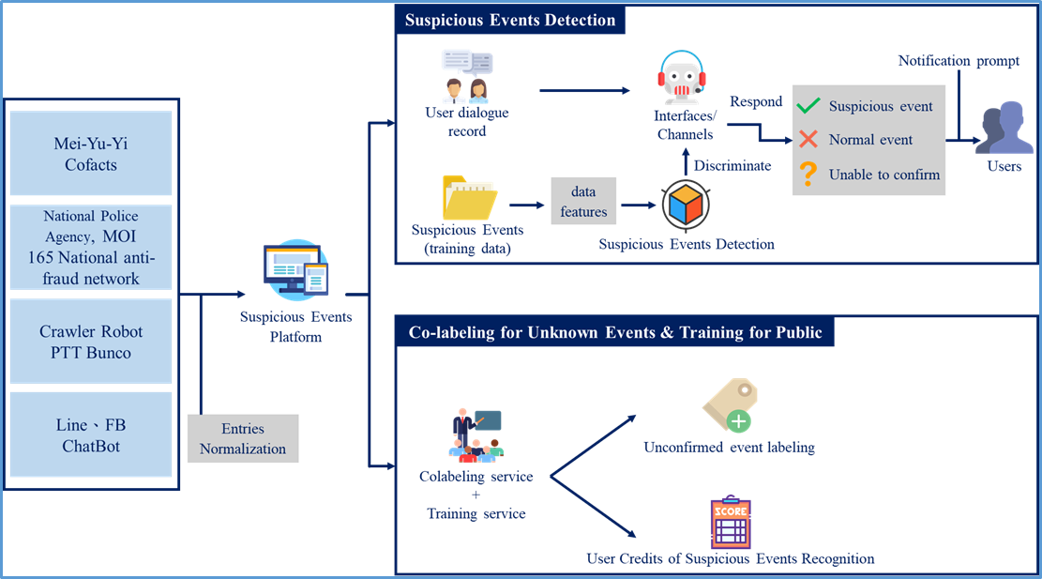
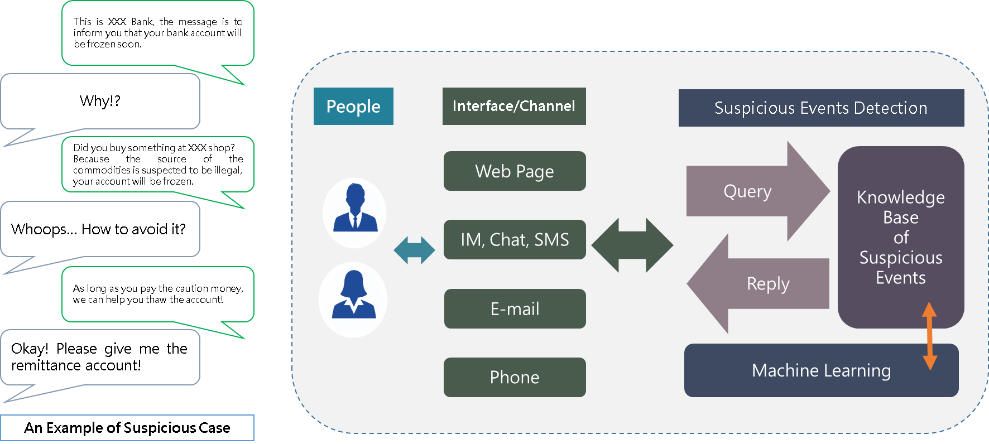
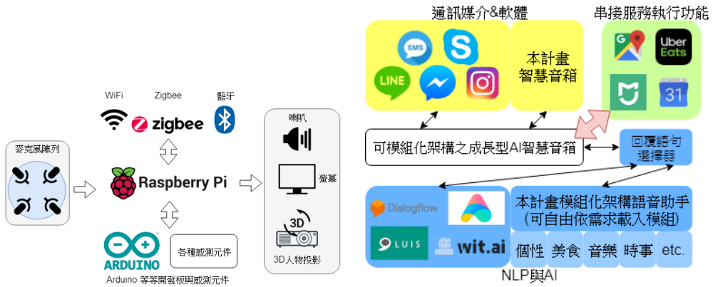
Smart Speaker / Chatbot

Slide 30
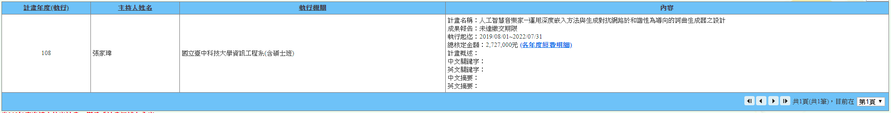
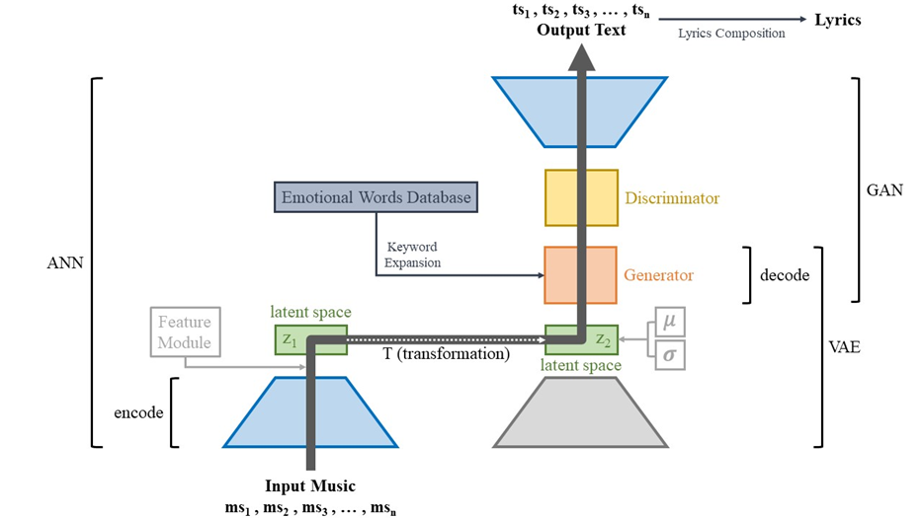
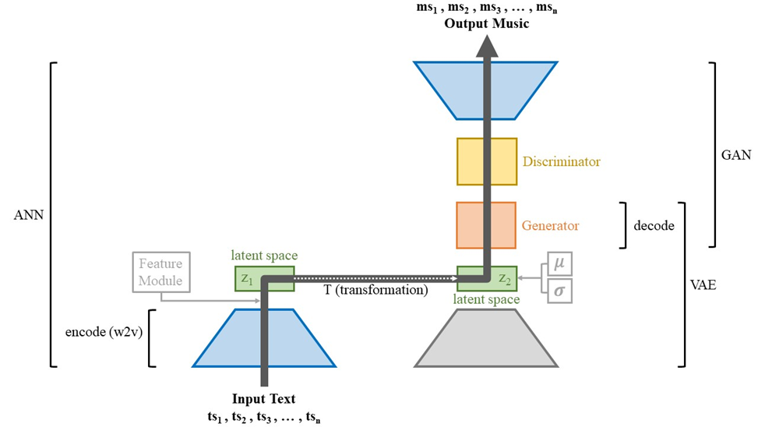
A.I. Musician

Slide 31
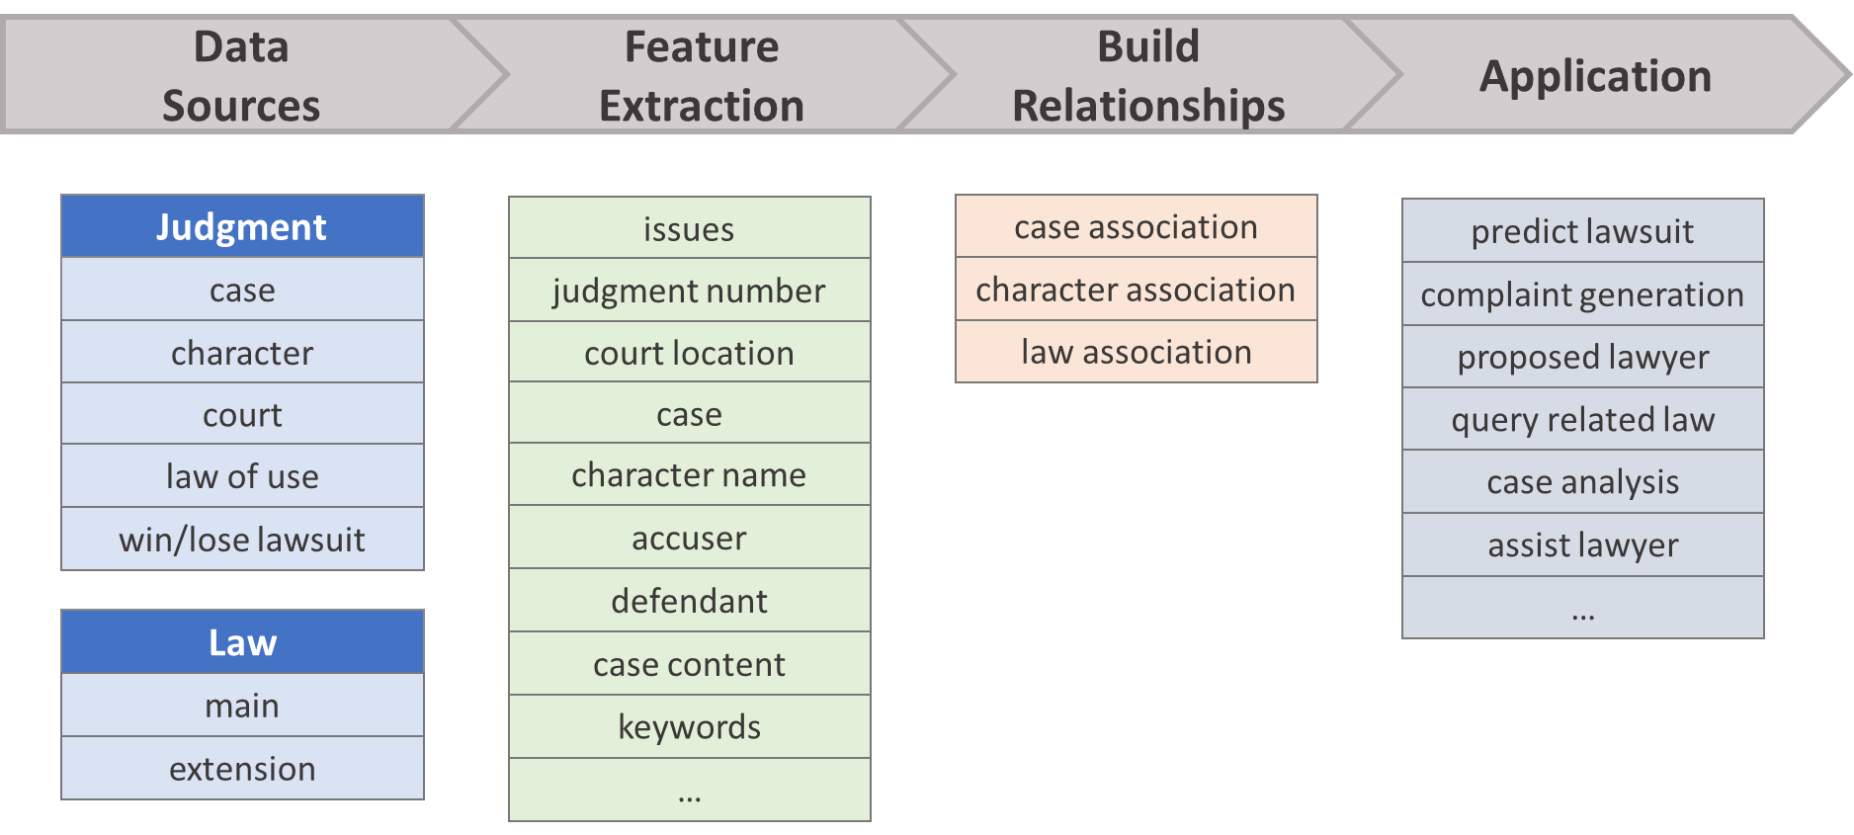

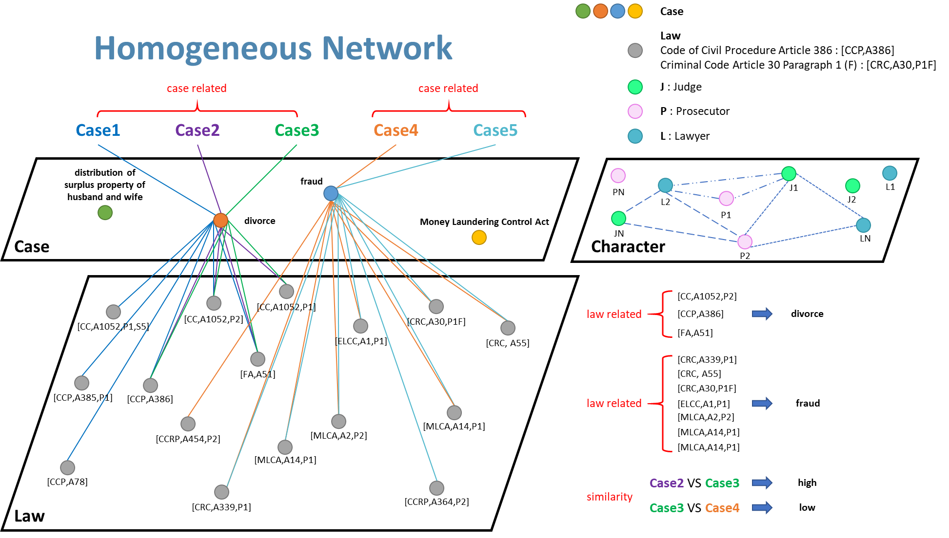
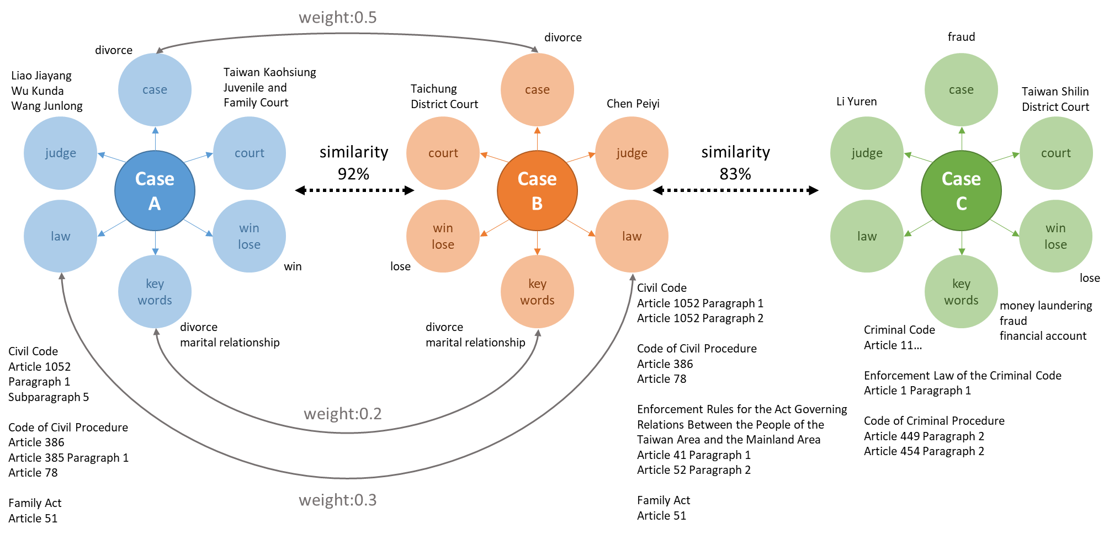
A.I. Lawyer

Slide 32

Artificial Intelligence
A.I. is not the GOAL !!!
A. I. cannot replace all the people.
A. I. only can replace the people who cannot use A. I.
A. I. can use to do
consuming manpower
dangerous
routine
boring
a specific task

Slide 33
Perceptron
MLP
ANN(DNN)
Natural Language Processing Lab, National Taichung University of Science and Technology

Slide 34
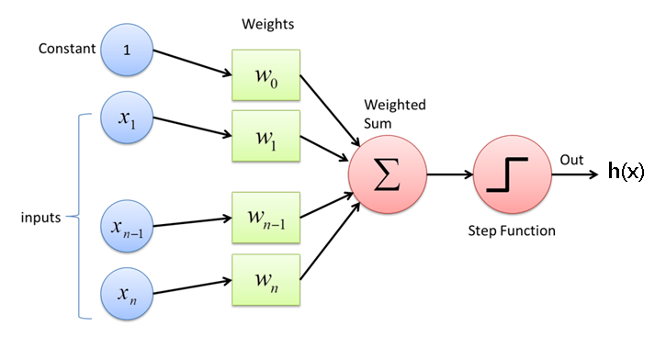
Perceptron Linear Algorithm
h(x) > 0
+
Features: x = (x₁, x₂)
Target: y = +1 or -1
h(x) = w₀ + w₁x₁ + w₂x₂
+
h(x) = 0
x₂
+
+
-
+
-
-
-
-
h(x) < 0
x₁
34

Slide 35
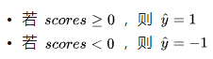
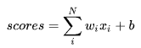
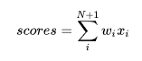
Perceptron Linear Algorithm
h(x) > 0
+
+
h(x) = 0
h(x) = w₀ + w₁x₁ + w₂x₂
x₂
+
+
-
+
-
-
-
-
h(x) < 0
x₁
35

Slide 36
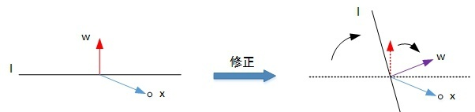
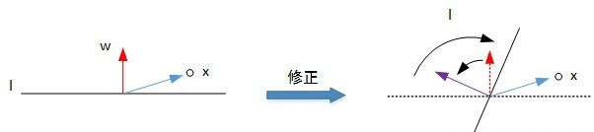
Perceptron Linear Algorithm
h(x) > 0
+
h(x) = 0
x₂
+
+
+
-
若 scores >= 0，則 y = 1
若 scores < 0，則 y = -1
+
-
-
h(x) < 0
-
-
x₁
ㄨㄨ…我是+1啦
[Case 1]
y = 1 錯分成 y = -1
+
-
w_{t+1} = w_{t} + y_{t}x_{t}
[Case 2]
y = -1 錯分成 y = 1
-
+
w_{t+1} = w_{t} + y_{t}x_{t}
ㄨㄨ…我是-1啦
36

Slide 37
Perceptron Linear Algorithm
h(x) > 0
+
h(x) = 0
x₂
+
+
+
-
若 scores >= 0，則 y = 1
若 scores < 0，則 y = -1
+
-
-
h(x) < 0
-
-
x₁
ya…正名為+1啦!
[Case 1]
y = 1 錯分成 y = -1
+
-
+
w_{t+1} = w_{t} + y_{t}x_{t}
ya…正名為-1啦!
[Case 2]
y = -1 錯分成 y = 1
-
+
-
w_{t+1} = w_{t} + y_{t}x_{t}
37

Slide 38
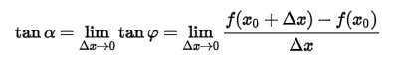
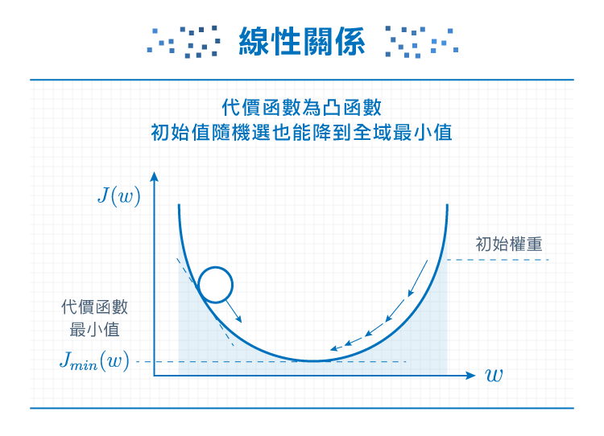
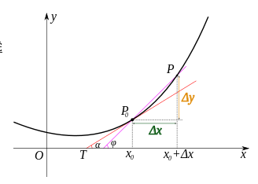
Gradient Descent
Natural Language Processing Lab, National Taichung University of Science and Technology

Slide 39
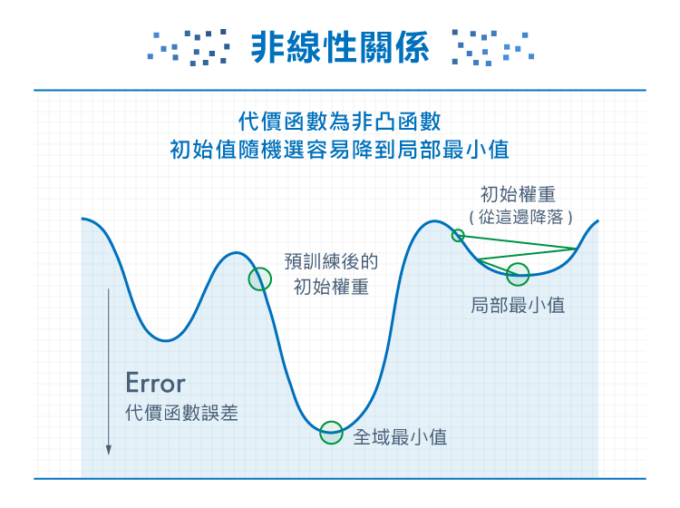
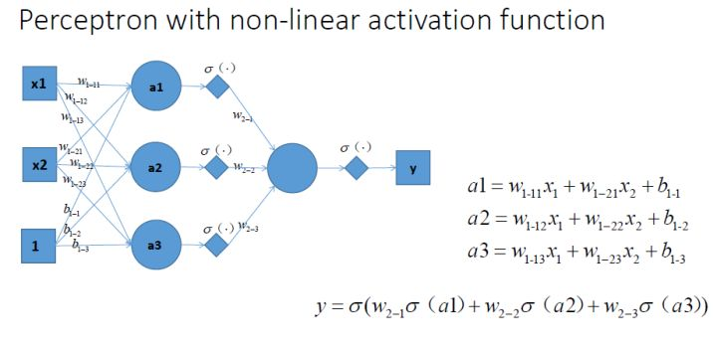
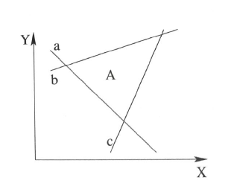
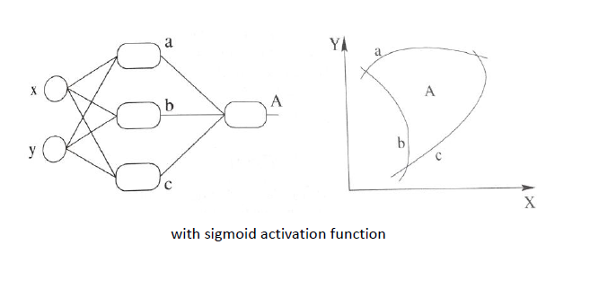
Activation Functions
*現實世界的資料多為非線性，因此激活函數通常也是使用非線性函數(非凸函數)傳遞
Natural Language Processing Lab, National Taichung University of Science and Technology

Slide 40
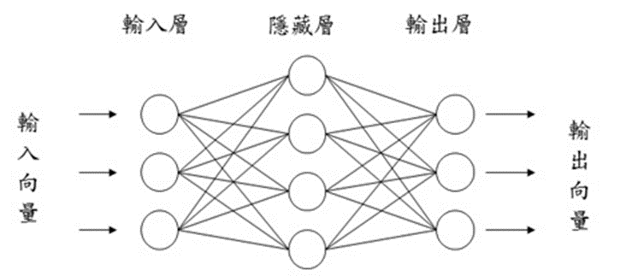
Multi-Layer Perceptron (MLP)
*線性組合
Natural Language Processing Lab, National Taichung University of Science and Technology

Slide 41
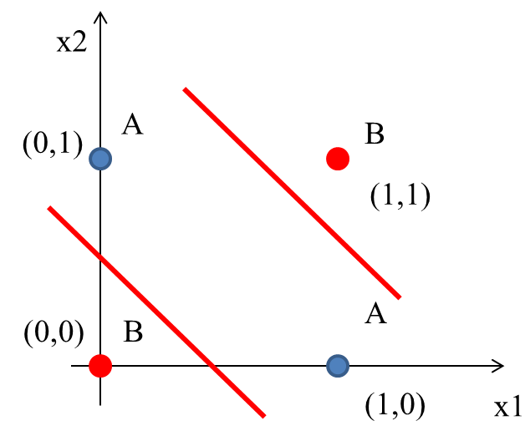


MLP for XOR Problem
XOR Implementation
Natural Language Processing Lab, National Taichung University of Science and Technology

Slide 42
MLP to DNN
多層感知機(MLP)其實就是可以用多層和多個神經元(Perceptron)來處理非線性問題，就像用很多個回歸方法/線性分類器一層一層疊加來達到目的，概念雷同機器學習領域的ensemble learning。
中間的 hidden layers 則是在做資料的特徵擷取(也可稱為embedding)，可根據目的來降維或增加維度，藉此從資料習得深度特徵(通常是更有意義的特徵)，最後的輸出才是做分類。
隱藏層數增多就可稱為深度神經網路(deep neural network, DNN)，所以最簡單的DNN其實就是MLP的擴增版。
Natural Language Processing Lab, National Taichung University of Science and Technology

Slide 43

Backpropagation
Perceptron
x
f
y
dy/dx
e = y’-y
e = y’-y
dy/dx
x
f
z
f
y
dz/dx
dy/dz
$$\frac{σy}{σx}=\frac{∆y}{∆z}\frac{∆z}{∆x}$$
MLP
Natural Language Processing Lab, National Taichung University of Science and Technology

Slide 44
CNN
RNN
LSTM
Natural Language Processing Lab, National Taichung University of Science and Technology

Slide 45


Convolutional Neural Network
Natural Language Processing Lab, National Taichung University of Science and Technology

Slide 46



Convolutional Neural Network
卷積層的運作
Natural Language Processing Lab, National Taichung University of Science and Technology

Slide 47

Convolutional Neural Network
最大池化層的運作
Natural Language Processing Lab, National Taichung University of Science and Technology

Slide 48


Convolutional Neural Network
Natural Language Processing Lab, National Taichung University of Science and Technology

Slide 49
Recurrent Neural Network, RNN

Slide 50

Recurrent Neural Network
*tanh is usually used to be the activation function in RNN
Natural Language Processing Lab, National Taichung University of Science and Technology

Slide 51

Recurrent Neural Network
RNN 對 short-term 敏感
RNN 對 long-term 容易遺忘
越前面的字越會遺忘… 這就是RNN的梯度消失…
公式 h₀ 對 h_{t} 的影響力為 w 的 t 次方，通常，w 會小於 1，離目標字越遠的字詞經過越多次傳遞(連乘)… 影響力幾乎不見了。
Natural Language Processing Lab, National Taichung University of Science and Technology

Slide 52

Long Short Term Memory
純的 input (x₁,x₂,…,x_{n})，以下三個gate會影響這個input能否被記住或作為輸出
2. Input gate，如果值為0就擋住，不給進下一層 (by sigmoid)
3. Forget gate，如果值近似0，就把區塊裡記住的值忘掉(by sigmoid)
4. Output gate，決定在區塊記憶中的input是否能輸出 (by sigmoid)
Natural Language Processing Lab, National Taichung University of Science and Technology

Slide 53

Long Short Term Memory
Natural Language Processing Lab, National Taichung University of Science and Technology

Slide 54

Vanishing/Exploding Gradient Problem
CNN 用 ReLU
Sigmoid微分後的值域是[0~0.25] ； tanh微分後的值域是[0~1] ； ReLU微分後的值域為[0 or 1]。
若CNN每層都使用sigmoid，小於1的導函數的多次連乘引發梯度消失。
tanh的導函數雖然可以達到1，但在邊緣仍然會有梯度消失的問題出現。相較 sigmoid，tanh在一定程度上減輕了梯度消失。
ReLU的右半區沒有梯度消失，但左半區存在梯度消失，但也有人認為左半區可以使用給予稀疏矩陣，有一定正則化的效果。最重要的是，ReLU的計算量是遠小於sigmoid和tanh。
RNN 用 tanh
GRU和LSTM隱藏層狀態的激活函數一般使用的tanh；它們內部的各種門，因為是0-1的輸出，所以一般用sigmoid函數。
RNN每個時間步的參數矩陣W是相同的，不加激活函數的話相當於W的連乘，那么W中絕對值小於1的元素會在連乘中快速變成0，絕對值大於1的元素在連乘中快速變無窮大 所以，RNN就會比CNN更容易出現“梯度消失”和“梯度爆炸”。
了解RNN會爆炸的原因，就能明白 ReLU 不太適合用在RNN。
Natural Language Processing Lab, National Taichung University of Science and Technology

Slide 55
GAN
CGAN
Natural Language Processing Lab, National Taichung University of Science and Technology

Slide 56


Generative Adversarial Network
Natural Language Processing Lab, National Taichung University of Science and Technology

Slide 57

Conditional Generative Adversarial Network
Natural Language Processing Lab, National Taichung University of Science and Technology

Slide 58
Transformer
BERT
Natural Language Processing Lab, National Taichung University of Science and Technology

Slide 59

What is attention?

Slide 60

Why
無法有效地平行運算
Notes:
https://leemeng.tw/neural-machine-translation-with-transformer-and-tensorflow2.html#Encoder-Decoder-%E6%A8%A1%E5%9E%8B-+-%E6%B3%A8%E6%84%8F%E5%8A%9B%E6%A9%9F%E5%88%B6

Slide 61

Transformer structure
Notes:
https://leemeng.tw/neural-machine-translation-with-transformer-and-tensorflow2.html#Encoder-Decoder-%E6%A8%A1%E5%9E%8B-+-%E6%B3%A8%E6%84%8F%E5%8A%9B%E6%A9%9F%E5%88%B6

Slide 62

Transformer structure
Notes:
https://leemeng.tw/neural-machine-translation-with-transformer-and-tensorflow2.html#Encoder-Decoder-%E6%A8%A1%E5%9E%8B-+-%E6%B3%A8%E6%84%8F%E5%8A%9B%E6%A9%9F%E5%88%B6

Slide 63

Transformer structure
Notes:
https://leemeng.tw/neural-machine-translation-with-transformer-and-tensorflow2.html#Encoder-Decoder-%E6%A8%A1%E5%9E%8B-+-%E6%B3%A8%E6%84%8F%E5%8A%9B%E6%A9%9F%E5%88%B6

Slide 64

Transformer structure
Notes:
https://leemeng.tw/neural-machine-translation-with-transformer-and-tensorflow2.html#Encoder-Decoder-%E6%A8%A1%E5%9E%8B-+-%E6%B3%A8%E6%84%8F%E5%8A%9B%E6%A9%9F%E5%88%B6
https://www.youtube.com/watch?v=ugWDIIOHtPA&list=PLJV_el3uVTsOK_ZK5L0Iv_EQoL1JefRL4&index=61&t=0s

Slide 65

Results
Notes:
https://leemeng.tw/neural-machine-translation-with-transformer-and-tensorflow2.html#Encoder-Decoder-%E6%A8%A1%E5%9E%8B-+-%E6%B3%A8%E6%84%8F%E5%8A%9B%E6%A9%9F%E5%88%B6
https://www.youtube.com/watch?v=ugWDIIOHtPA&list=PLJV_el3uVTsOK_ZK5L0Iv_EQoL1JefRL4&index=61&t=0s

Slide 66

BERT= Encoder of Transformer
Notes:
https://leemeng.tw/attack_on_bert_transfer_learning_in_nlp.html
https://youtu.be/UYPa347-DdE?list=PLJV_el3uVTsOK_ZK5L0Iv_EQoL1JefRL4

Slide 67


BERT Structure
Notes:
https://leemeng.tw/attack_on_bert_transfer_learning_in_nlp.html
https://youtu.be/UYPa347-DdE?list=PLJV_el3uVTsOK_ZK5L0Iv_EQoL1JefRL4

Slide 68

Training of BERT
Notes:
https://leemeng.tw/attack_on_bert_transfer_learning_in_nlp.html
https://youtu.be/UYPa347-DdE?list=PLJV_el3uVTsOK_ZK5L0Iv_EQoL1JefRL4

Slide 69

Key points of BERT
Notes:
https://leemeng.tw/attack_on_bert_transfer_learning_in_nlp.html
https://youtu.be/UYPa347-DdE?list=PLJV_el3uVTsOK_ZK5L0Iv_EQoL1JefRL4

Slide 70
Thank You

